Slide 1

CRIME REPORTING SOFTWARE

Slide 2
AKNOWLEDGMENT
I express my sincere gratitude to our Principal, Mrs. Anila Jayachandran and vice principle, Mrs. Mini C P for giving me the opportunity to hone my skills and expand my knowledge in computer science.
I also thank them for providing the facilities to work on the project.
I also thank our computer science teacher Mrs. Suma U Nambisan for her constant support and guidance without which we couldn’t have successfully completed the project. I would also like to thank my group members for their support and hard work which made the project better. I would also like to thank all of my friends who provided me with helpful criticisms along the way which helped me to engineer this program beautifully as it is now.
I would also like to thank my parents who provided me with additional gadgets and other amenities and also for their encouragement and support. I would also like to thank CBSE for providing the opportunity to be introduced to the realm of computer programming
Last but not the least I would like to thank all those who directly or indirectly helped me and my group members in completion of our project.

Slide 3
CONTENTS

Slide 4
INTRODUCTION
The "Crime Reporting Software" has been developed to improve the efficiency of reporting crime. This software is supported to initiate a quick response whenever a crime is reported. Moreover, this system is designed for the masses to report any crime they come across at the moment's notice. It's designed in a user-friendly manner, with descriptive evidence provided on the spot, will help the police with access to adequate and reliable evidence. .
This software if made with portability in mind. All features can be accessed within a few seconds after installation

Slide 5
SCOPE OF THE PROGRAM
The program is divided into two main sections:-.
Users:- which includes admins and registered members.
Crimes:- which includes all reported data.
All information regarding the users is stored in a database "login" which includes userno, name, password, phoneno and admin details.
All details are stored and fetched from MySQL database "Login".

Slide 6
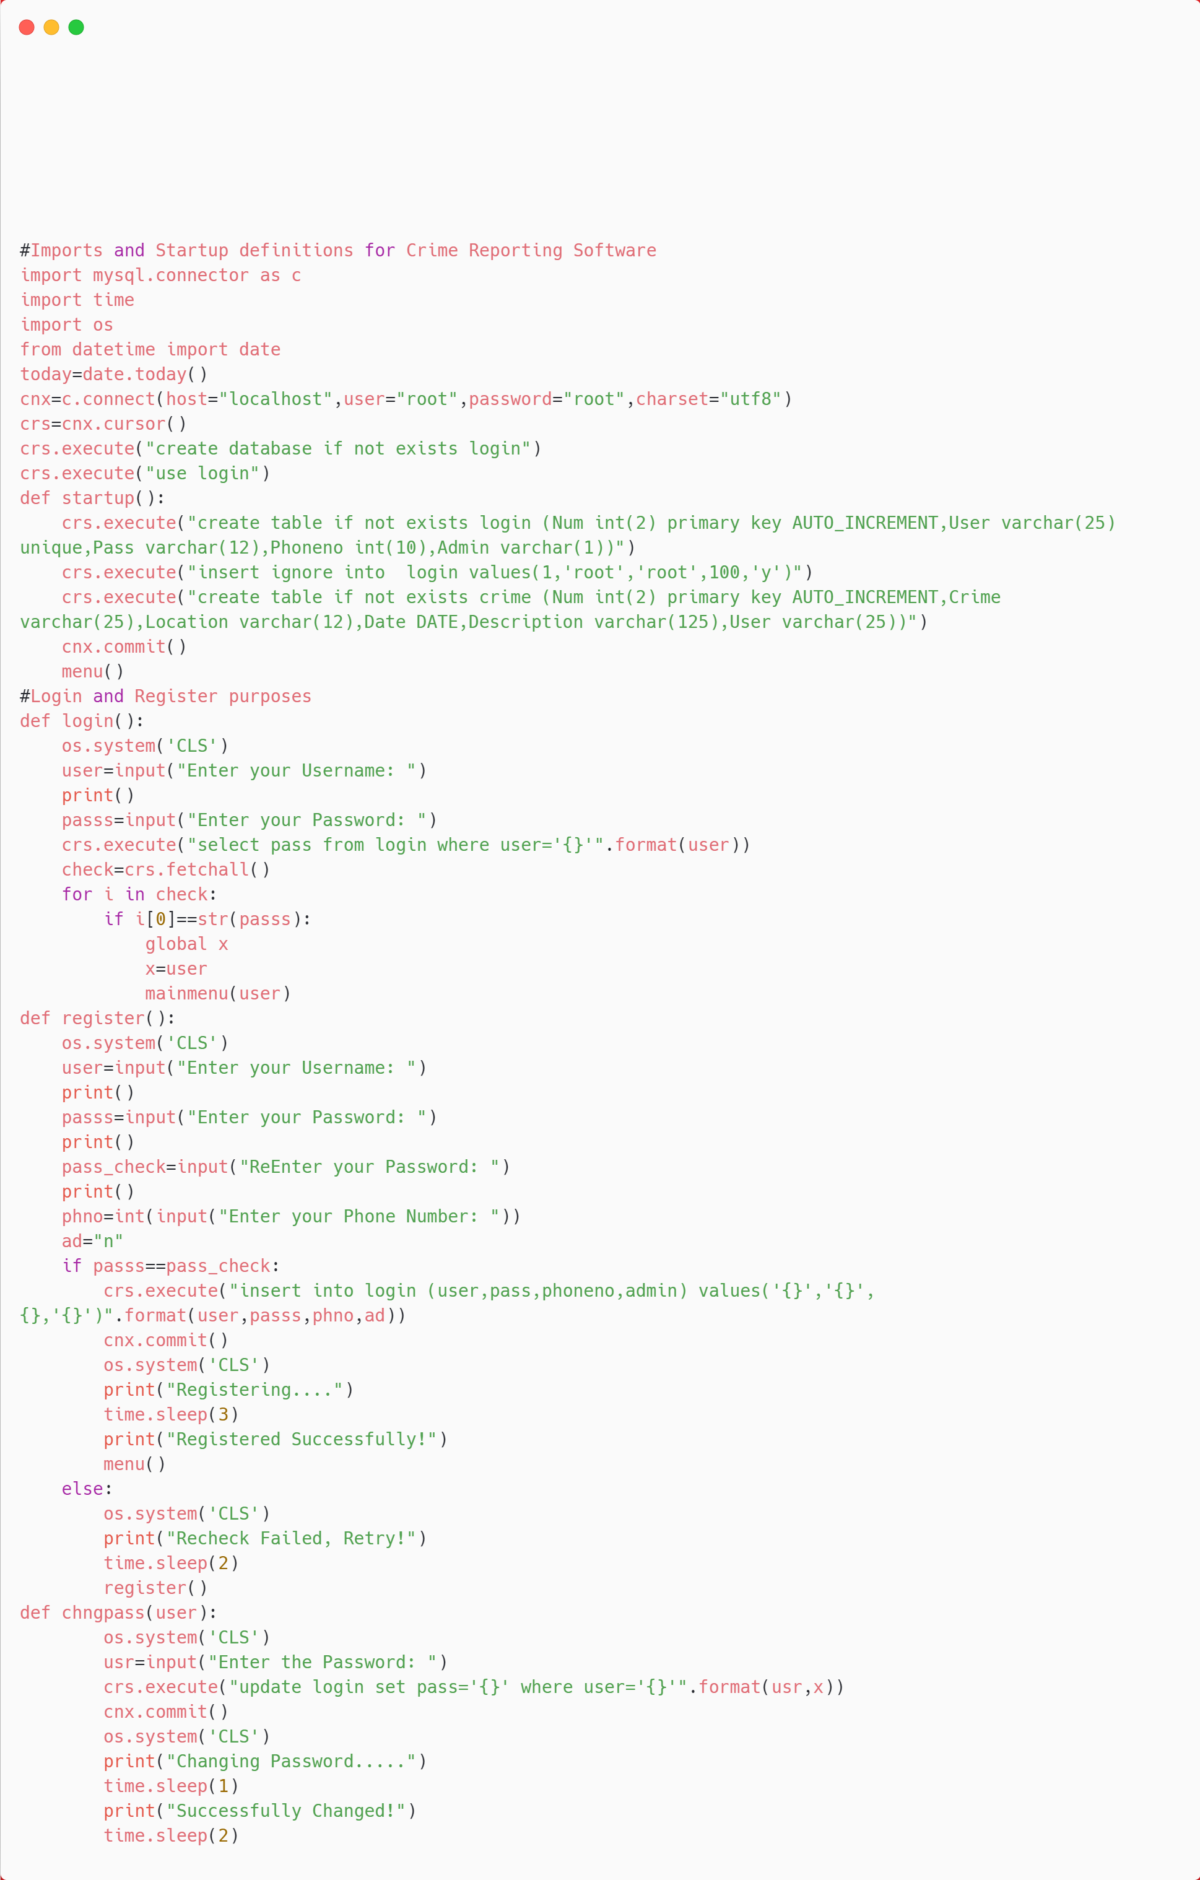
SOURCE CODE

Slide 7
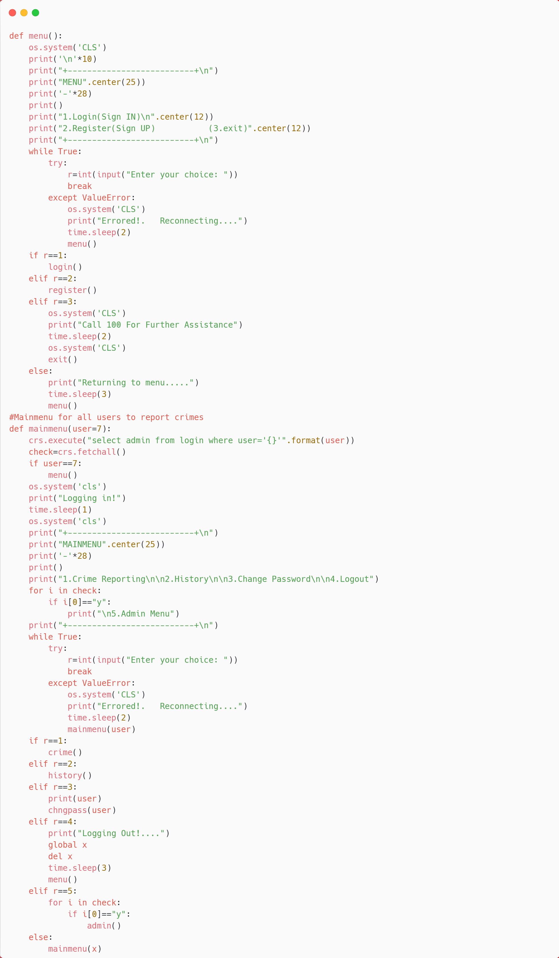

Slide 8
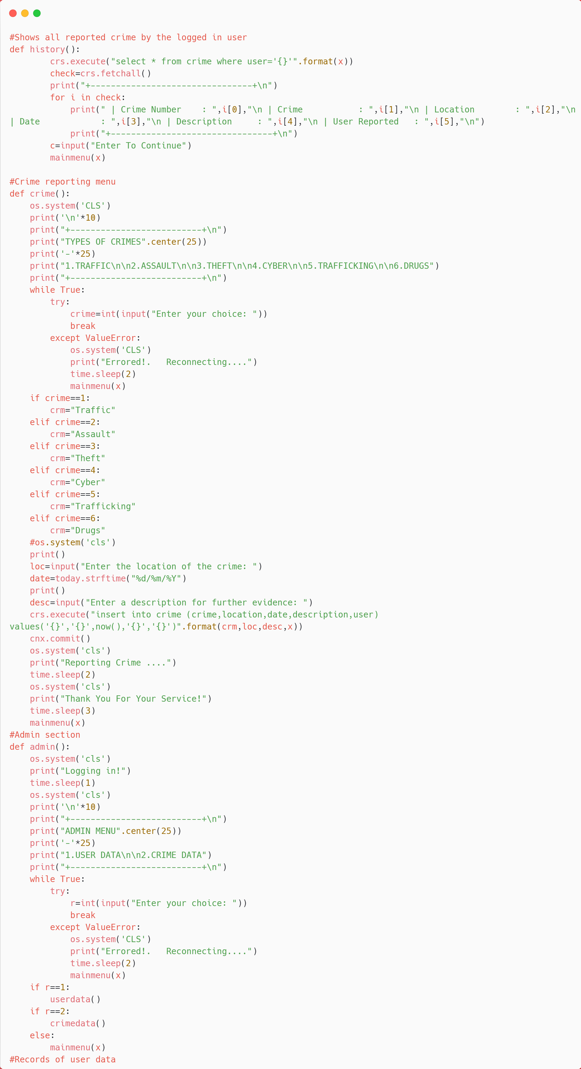

Slide 9
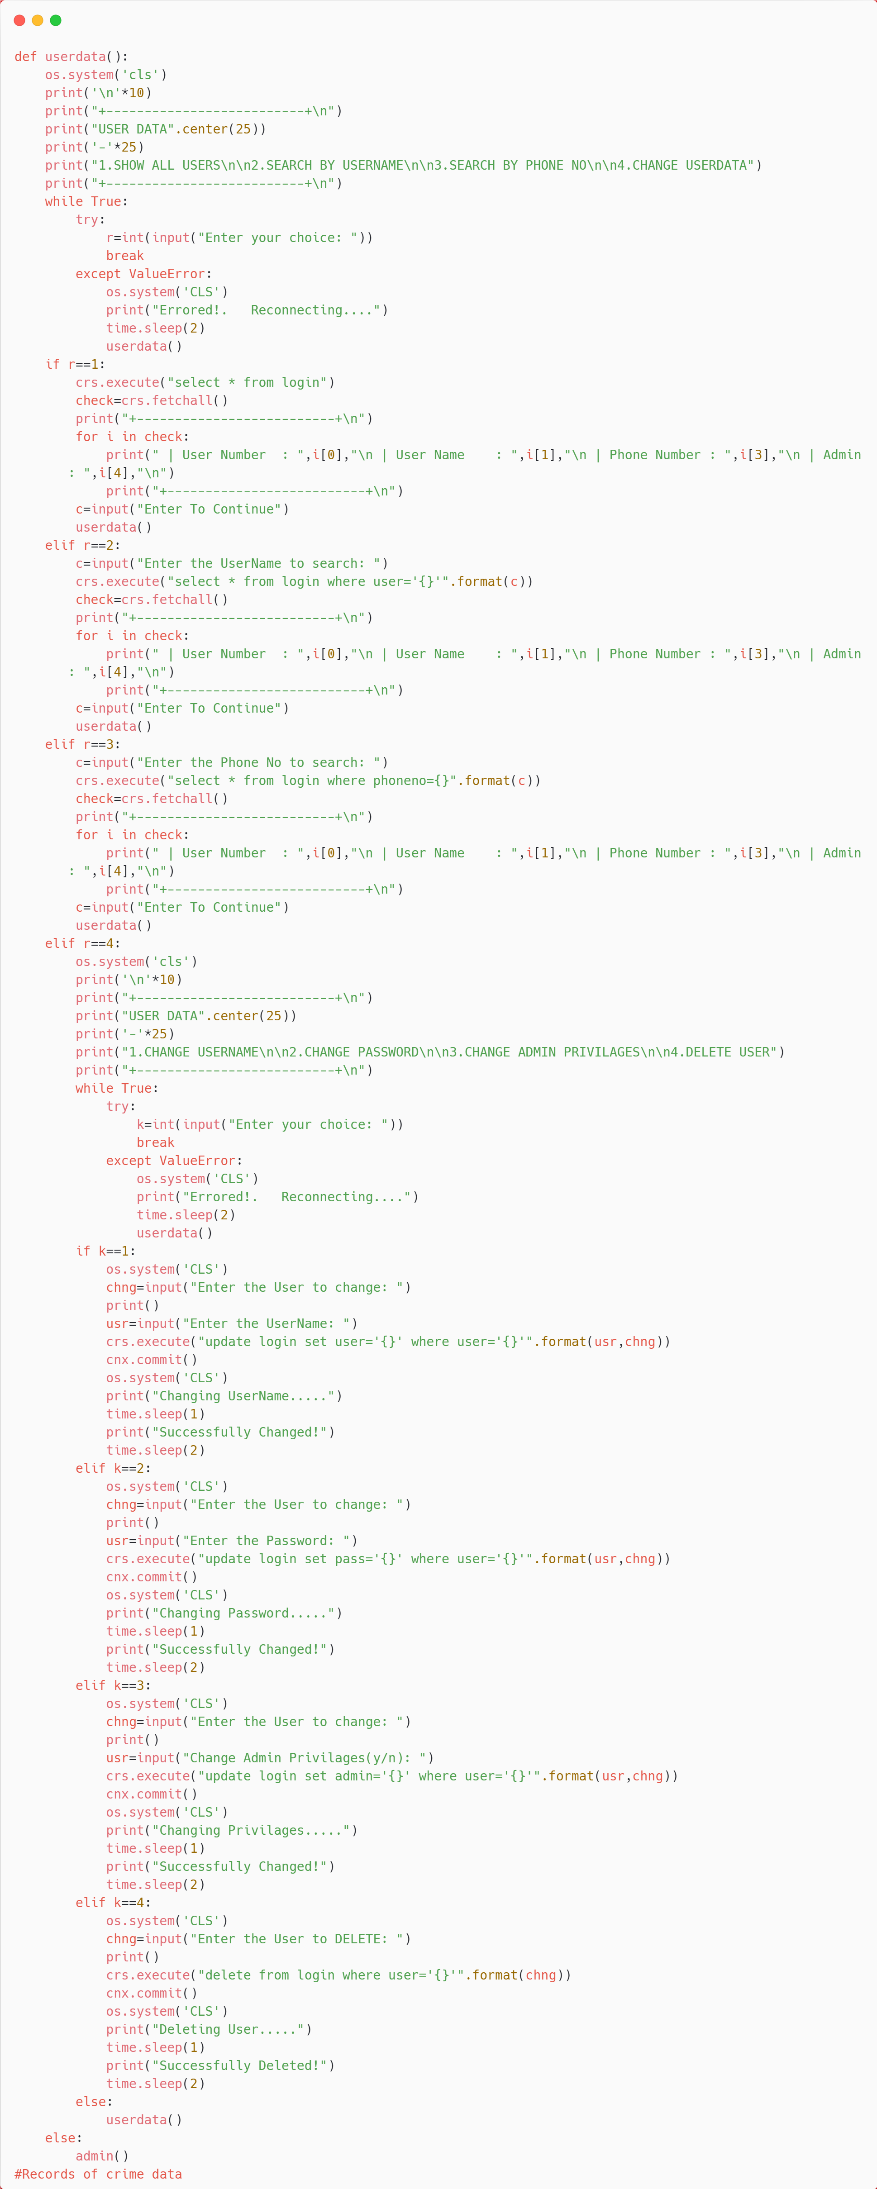

Slide 10
